Slide 1
RNNs and LSTMs

Slide 2
Recurrent Neural Networks
Humans don’t start their thinking from scratch every second.
understand each word based on your understanding of previous words
thoughts have persistence
Traditional neural networks can’t do this, and it seems like a major shortcoming

Slide 3
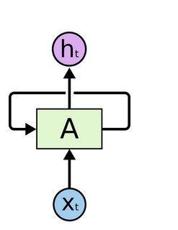
Recurrent Neural Networks
They are networks with loops in them, allowing information to persist.
a chunk of neural network, A, looks at some input xt and outputs a value ht
loop allows information to be passed from one step of the network to the next

Slide 4
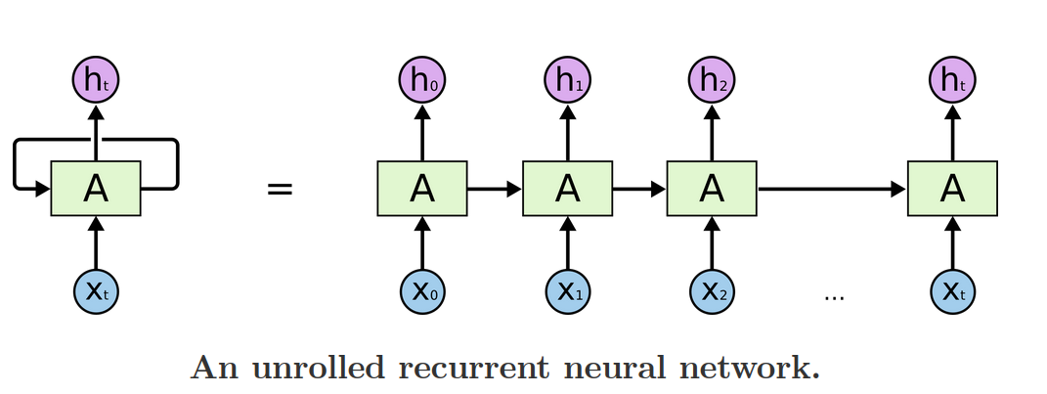
Recurrent Neural Networks
Can be thought of as multiple copies of the same network, each passing a message to a successor.
we unroll the loop

Slide 5
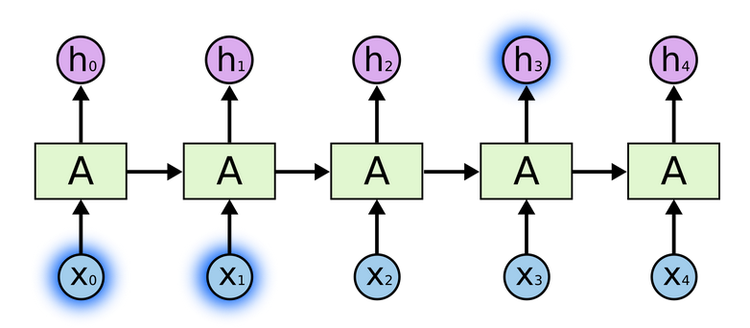
Look at recent information to perform present task
To predict the last word in “the clouds are in the sky,”
Gap between the relevant information and the place that it’s needed is small

Slide 6
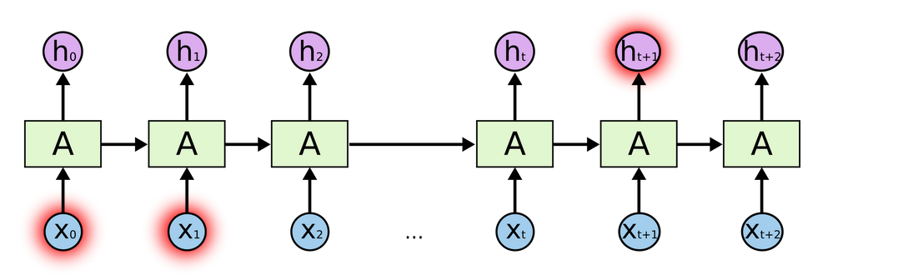
Need more context
To predict the last word in the text “I grew up in France… I speak fluent French.”
Gap between the relevant information and the point where it is needed to become very large
RNNs become unable to learn to connect the information

Slide 7
Need more context
RNNs are absolutely capable of handling such “long-term dependencies.”
A human could carefully pick parameters for them to solve toy problems of this form.
Sadly, in practice, RNNs don’t seem to be able to learn them.
The problem was explored in depth by Hochreiter (1991) [German] and Bengio, et al. (1994), who found some pretty fundamental reasons why it might be difficult.

Slide 8
LSTM Networks
Special kind of RNN, capable of learning long-term dependencies
Introduced by Hochreiter & Schmidhuber (1997), and were refined and popularized by many people in following work
Explicitly designed to avoid the long-term dependency problem
Remembering information for long periods of time is practically their default behavior, not something they struggle to learn!

Slide 9
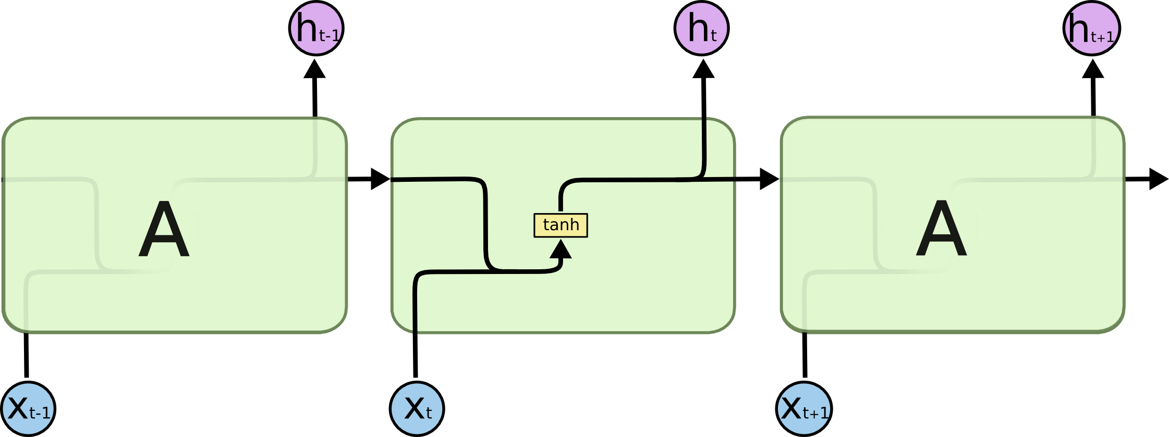
LSTM Networks
In standard RNNs, the repeating module will have a very simple structure, such as a single tanh layer

Slide 10
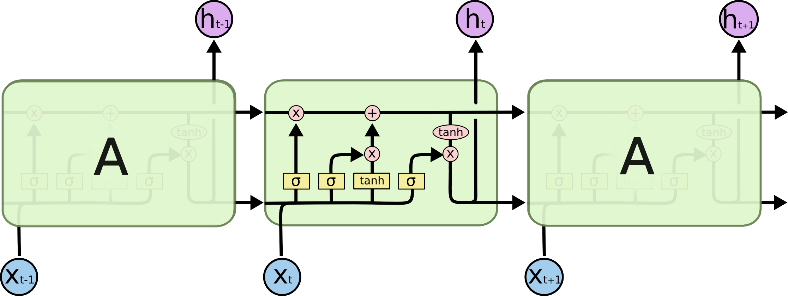
LSTM Networks
LSTMs also have this chain like structure, but with different repeating modules, there are four, interacting in a very special way.

Slide 11
Memories in LSTM
long-term memory (Ct) is what the model remembers across time, and short-term memory (ht) is what the model uses and outputs at the current step.
Cell state Ct → Knowledge in your brain
Hidden state ht → What you use in exams

Slide 12
Memories in LSTM
In an LSTM, each gate (forget, input, output, and candidate) has its own distinct weight matrices
W, U, and bias b, which are learned independently.
W - weights the current input
U - weights the previous hidden state (recurrent)
b - bias term
together they compute the gates and candidate memory at each time step

Slide 13
Classic RNNs
Memory = output
Everything gets overwritten
Long dependencies break
Long-term memory stores knowledge, short-term memory exposes a filtered view of it.

Slide 14
Long-term memory: the cell state Ct
A conveyor belt that runs almost unchanged
stores stable, slowly changing information
Updated additively, not overwritten
Protected from vanishing gradients
Controlled by forget and input gates

Slide 15
Think of the cell state as a conveyor belt
cell state C is like a memory conveyor belt running through time
Forget gate places valves on this belt:
1 → keep this memory
0 → erase this memory
0.3 → keep a little
0.9 → keep almost everything

Slide 16
Example
The movie, despite its slow start, was amazing
The sentiment (“positive”) needs to be remembered from the word amazing until the end.
That sentiment lives in long-term memory Ct.

Slide 17
Short-term memory: the hidden state ht
Your current thoughts
What you say out loud at this moment
It captures recent, context-specific information
Changes quickly at every time step
Used for:
Making predictions
Feeding the next layer
Influencing the next step

Slide 18
Example
The movie was amazing but too long
When processing “long”, the model focuses on:
Contrast word “but”
Immediate sentiment shift
hidden state is derived from the cell state - short term memory is derived from long term memory

Slide 19
Core Idea Behind LSTMs
Key to LSTMs is the cell state, the horizontal line running through the top of the diagram
Cell state is kind of like a conveyor belt
Runs straight down the entire chain, with only some minor linear interactions
Very easy for information to just flow along it unchanged

Slide 20
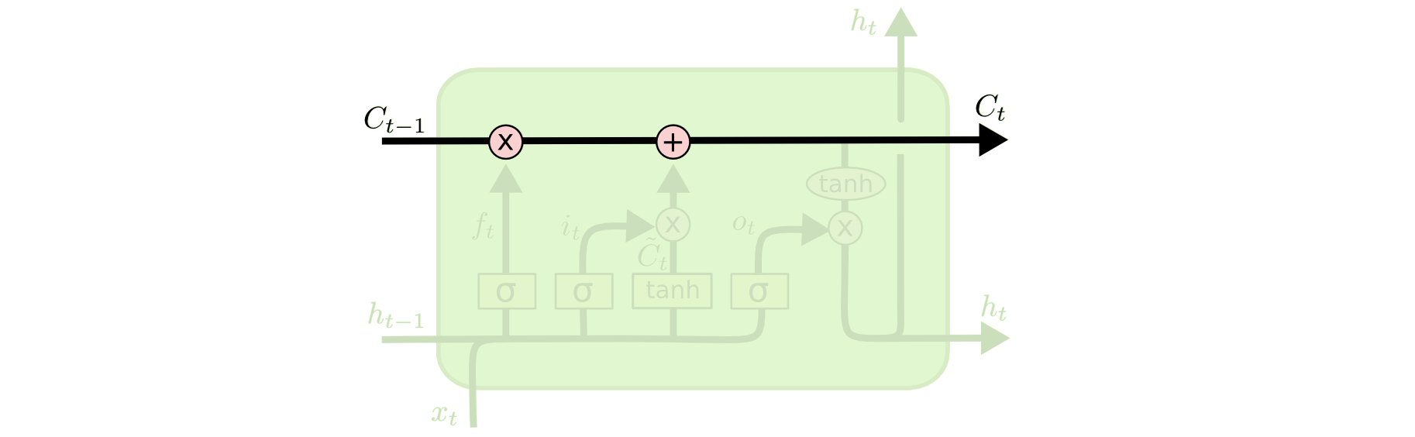
Core Idea Behind LSTMs

Slide 21
Core Idea Behind LSTMs
LSTM does have the ability to remove or add information to the cell state, carefully regulated by structures called gates
Gates are a way to optionally let information through.
They are composed out of a sigmoid neural net layer and a pointwise multiplication operation.

Slide 22
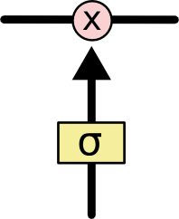
Core Idea Behind LSTMs
The sigmoid layer outputs numbers between zero and one, describing how much of each component should be let through.
A value of zero means “let nothing through,” while a value of one means “let everything through!”

Slide 23
LSTM Gates
LSTM has three of these gates, to protect and control the cell state
First step - decide what information we’re going to throw away from the cell state
decision is made by a sigmoid layer called the “forget gate layer.”

Slide 24
Forget Gate
Decide what information from the past should be kept and what should be forgotten.

Slide 25
Forget Gate
Takes h_{t−1} and x_{t}, and outputs a number between 0 and 1 for each number in the cell state C_{t−1}
1 - completely keep this
0 - completely get rid of this
In the language model trying to predict the next word based on all the previous ones, the cell state might include gender of present subject, so that correct pronouns can be used

Slide 26
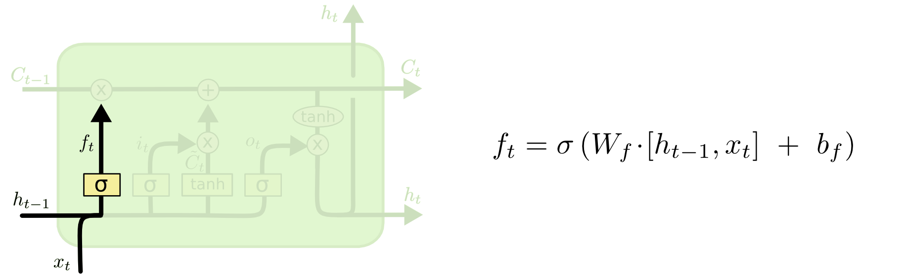
Forget Gate
When we see a new subject, we want to forget the gender of the old subject

Slide 27


Forget Gate
At time step t, the forget gate computes:
Then it updates the cell state:
x_{t} - current input
h_{t−1}: previous hidden state (summary of the past)
C_{t−1} : previous cell state (long-term memory)
f_{t} : forget gate output (values between 0 and 1)

Slide 28
Forget Gate
LSTM separates “remembering information” from “processing information”, and the sigmoid gates decide how much memory flows through time.
Sigmoid outputs values in (0, 1):
Perfect for how much to allow through
Acts like a soft switch, not a hard on/off

Slide 29
Decide what to store in the cell state
has two parts
a sigmoid layer called “input gate layer” decides which values we’ll update
tanh layer creates a vector of new candidate values, C̃_{t}, that could be added to the state
Combine these two to create an update to the state

Slide 30
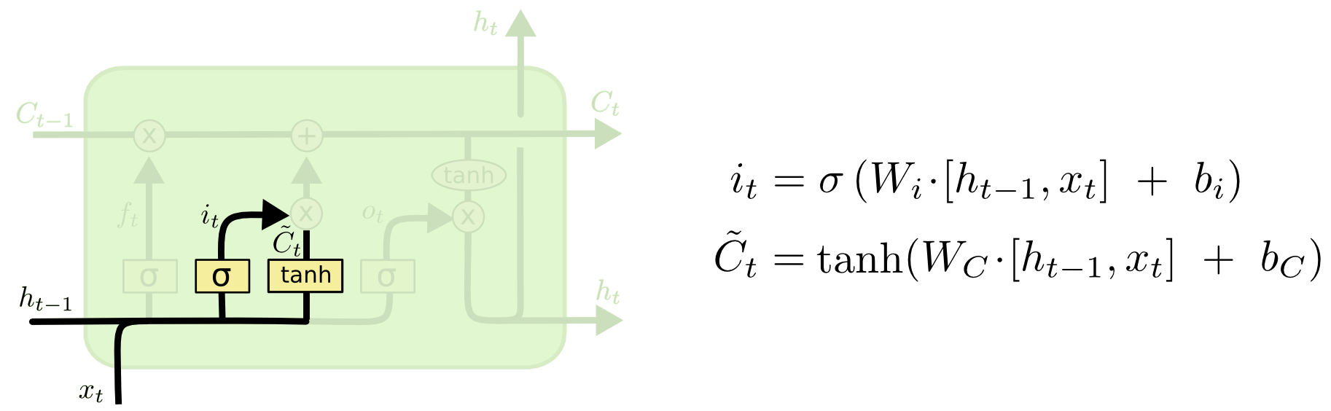
Decide what to store in the cell state
In the example of our language model, we’d want to add the gender of the new subject to the cell state, to replace the old one we’re forgetting.

Slide 31
Update Cell State
It’s now time to update the old cell state, C_{t−1}, into the new cell state C_{t}.
We multiply the old state by ft, forgetting the things we decided to forget earlier.
Then we add it∗C̃ t.
This is the new candidate values, scaled by how much we decided to update each state value.

Slide 32
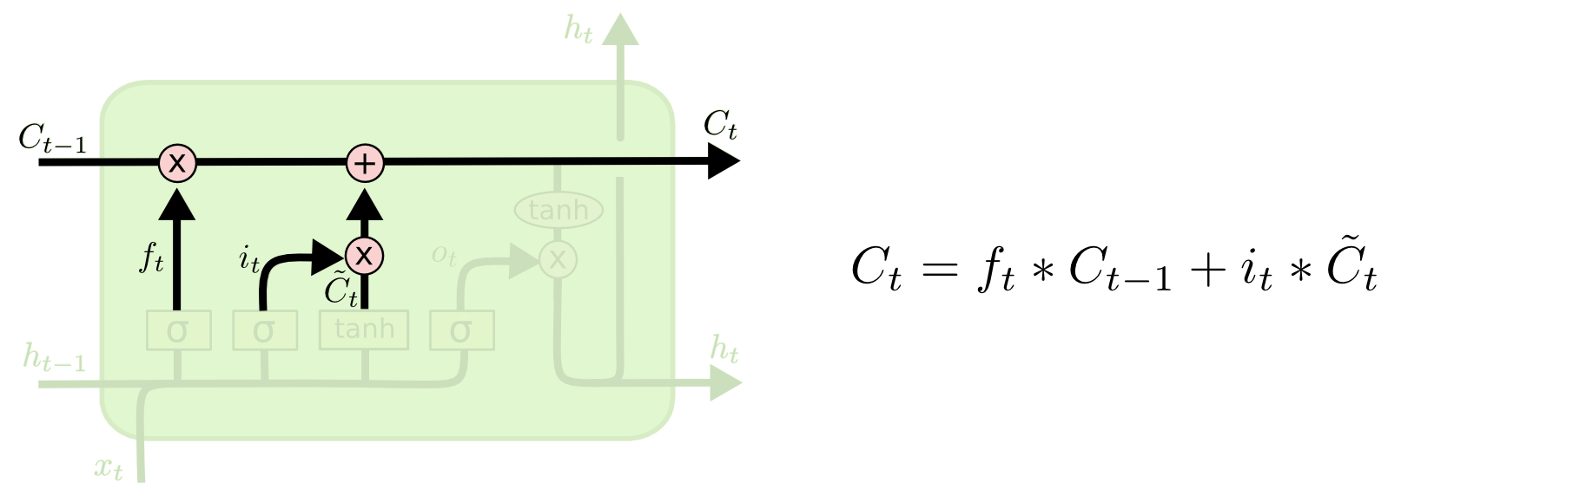
Update Cell State

Slide 33
Update Cell State
LSTM updates its long-term memory (cell state) by forgetting old information and adding new information
equation is the heart of LSTM
Start with old memory Ct−1
horizontal top line is the cell state conveyor belt.
It carries long-term memory forward
It is protected from sudden changes

Slide 34
Update Cell State
Forget gate decides what to erase (f_{t})
Topic changes → forget old topic
Same topic → retain memory

Slide 35

Candidate memory
Creates new content, but it is not added yet
Think of this as raw new knowledge - values in [−1,1]

Slide 36

Input gate decides what to write
Creates new content, but it is not added yet
Think of this as raw new knowledge - values in [−1,1]

Slide 37


Combine both: update memory
- Selective filtering
+ - memory accumulation
Old memory is scaled, not erased
New memory is added, not overwritten

Slide 38
Special
Unlike RNNs:
Memory is not repeatedly multiplied
Gradients flow smoothly through time
Solves the vanishing gradient problem
LSTM memory is updated by forgetting some old information and adding some new information, both controlled by sigmoid gates.

Slide 39
Decide what to Output
Output will be based on our cell state, but will be a filtered version
First, run a sigmoid layer which decides what parts of the cell state we’re going to output
Put the cell state through tanh (to push the values to be between −1 and 1) and multiply it by the output of the sigmoid gate, so that we only output the parts we decided to

Slide 40
Example
For the language model, since it just saw a subject, it might want to output information relevant to a verb, in case that’s what is coming next
For example, it might output whether the subject is singular or plural, so that we know what form a verb should be conjugated into if that’s what follows next

Slide 41
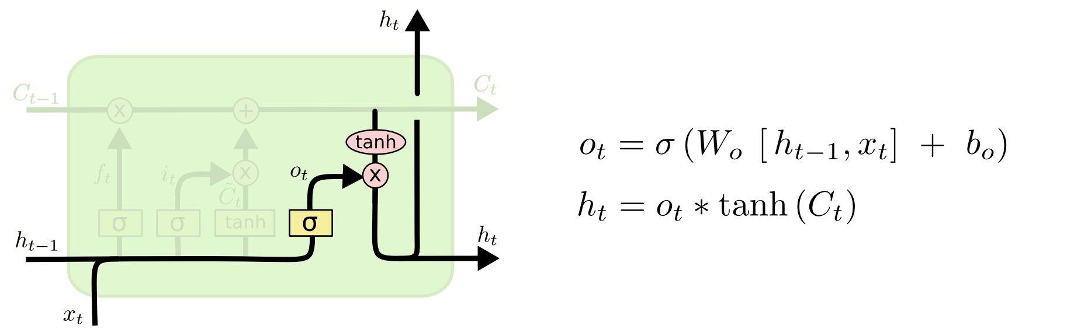
Output Layer
Ct - what you know
ot: what you choose to say
ht: what you express now

Slide 42
Output Layer
Output gate decides: What part of that memory matters right now
Cell state Ct → everything you know
Output gate ot → what you choose to say
Hidden state ht → what actually comes out of your mouth

Slide 43
Output Layer
Squash the cell state with tanh
Output gate decides what to show - uses sigmoid
Final hidden state - Some memory is revealed
Filtering in LSTMs is done via element-wise multiplication because it allows smooth, differentiable, per-dimension control over how much information is passed or blocked.

Slide 44
Choosing Sigmoid
Clean control in [0, 1]
Differentiable
Interpretable
Stable gradients
Ideal for control, not representation
The output gate controls how much of the long-term memory is exposed as the hidden state at the current time step.

Slide 45
LSTM responsibilities
Problem | LSTM solution
Forgetting old info | Cell state
Reacting to new input | Hidden state
Stable gradients | Additive updates
Selective exposure | Output gate

Slide 46
Gated Recurrent Unit (GRU)
Merges short-term and long-term memory into a single state ht
Two gates are used:
Reset gate r_{t} — how much past to use
Update gate zt - keep old or replace?
Candidate hidden state h~t

Slide 47
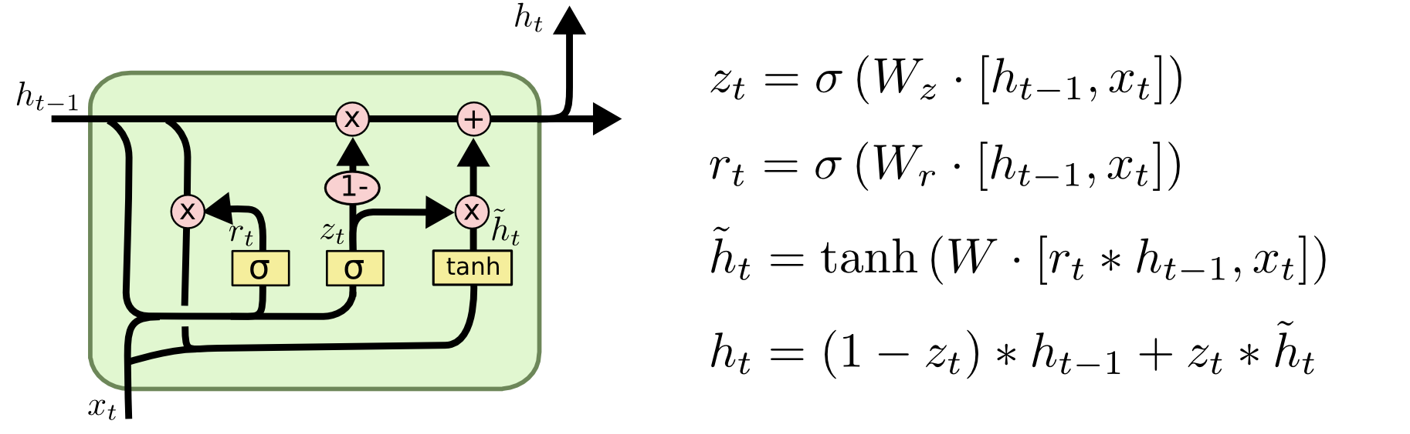
Gated Recurrent Unit (GRU)
Combines forget and input gates into a single “update gate.”
Also merges the cell state and hidden state, and makes some other changes

Slide 48
Gated Recurrent Unit (GRU)
Reset gate r_{t} — how much past to use
Use sigmoid function, multiplies h_{t-1}
Right bottom (tanh block)
Uses filtered past + current input
Produces new candidate information
Update gate z_{t} — keep old or replace?
Uses sigmoid function once again

